Slide 1
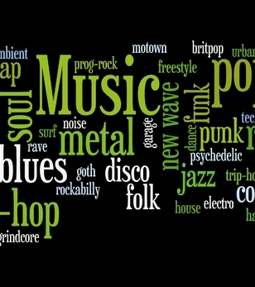

M.U.G.G.E. Mostly Unfinished Genre Grading Engine
As a project of the class Machine Learning at the University of Hamburg

Slide 2

Goals
Build a high performance model for basic learners
Accuracy of the model given a balanced medium size dataset while classifying 10 genres
Investigate different classifiers finding the most efficient one for classifying our genres
High performance predictions recording new input
Build a model capable of efficient predictions given new input

Slide 3
Music Genres for Classifying
Blues
Classical
Country
Disco
Hip Hop
Jazz
Metal
Pop
Reggae
Rock

Slide 4
Dataset
1000 songs
100 songs for each genre
Audio duration: 30 seconds
Source of dataset: Kaggle.com, GTZAN Dataset-Music Genre Classification

Slide 5
Features
Zero Crossing rate
Spectral Centroid
Mel-Frequency Cepstral Coefficients
Chroma Frequencies
Chords

Slide 6
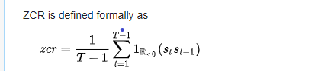
Zero Crossing Rate
The number of times the amplitude of the signal passes through a value of zero, within a time interval.
Measure of smoothness of an audio signal
Higher values for highly percussive sounds like those in metal and pop.
where s: signal of length T

Slide 7
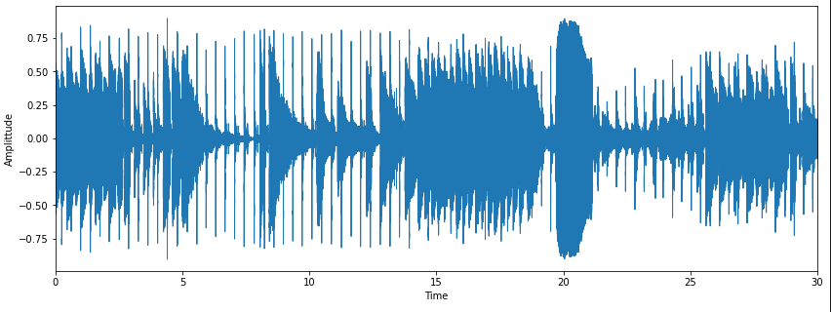
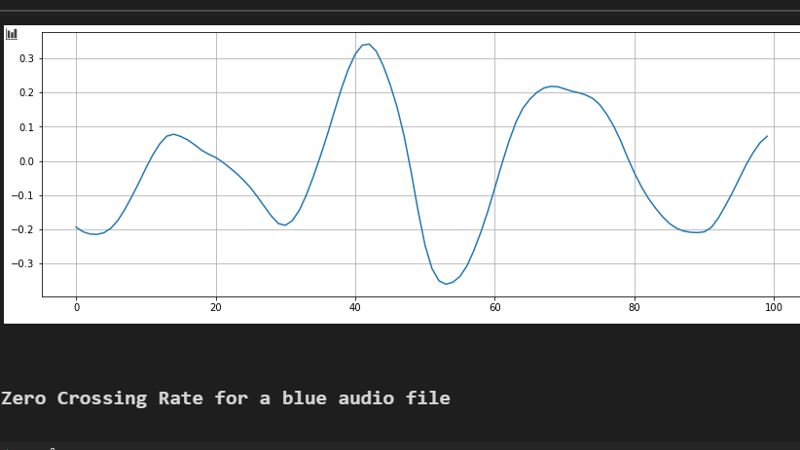
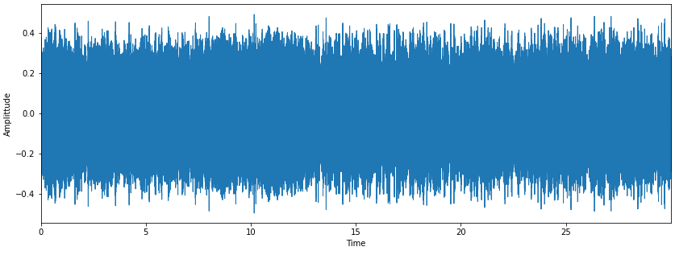
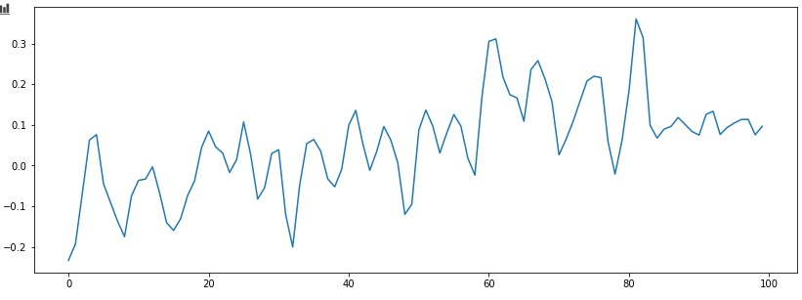
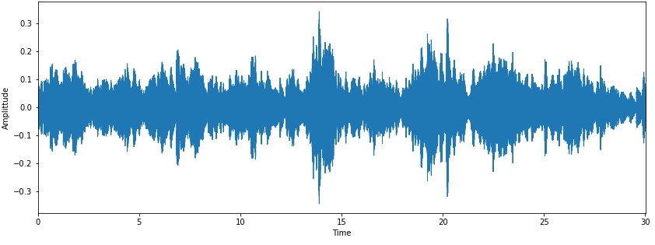
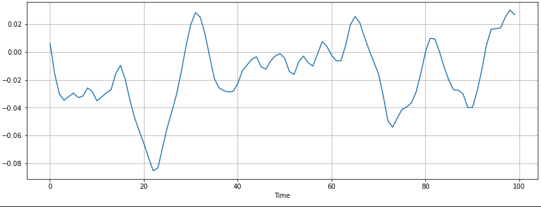
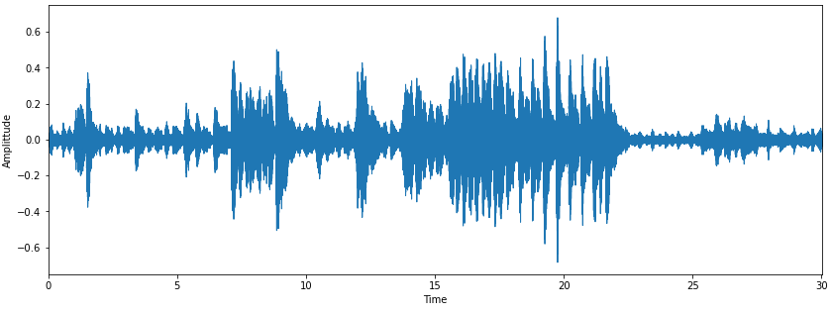
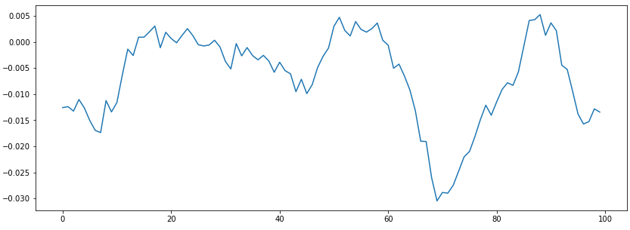
Blues Zero Crossings: 7
Metal Zero Crossings: 19
Classical Zero Crossings: 10
Jazz Zero Crossings: 12

Slide 8
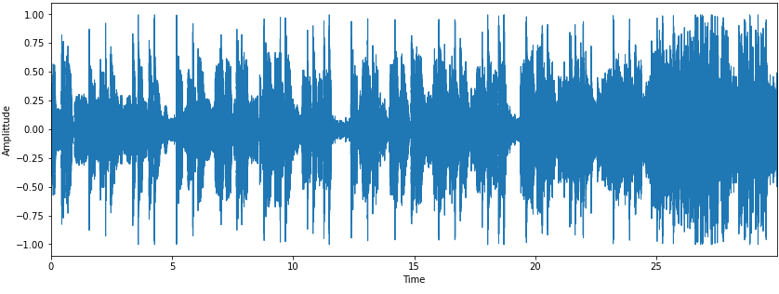
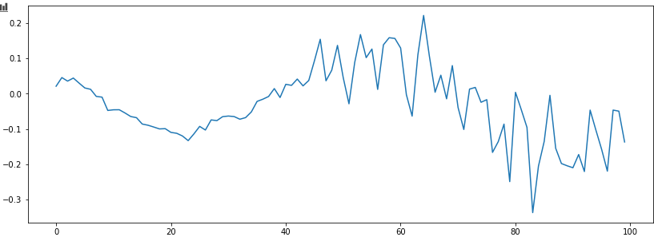
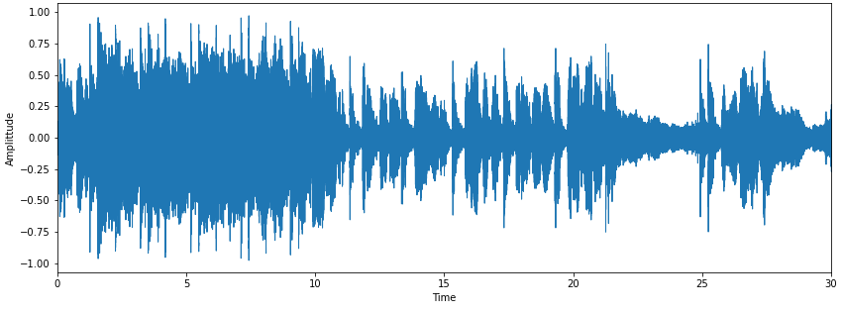
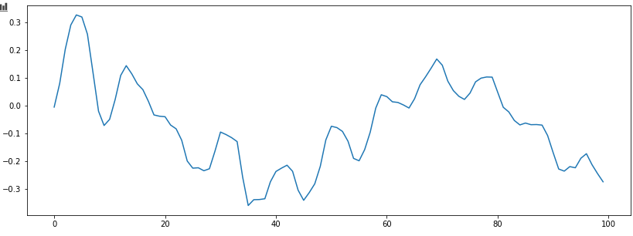
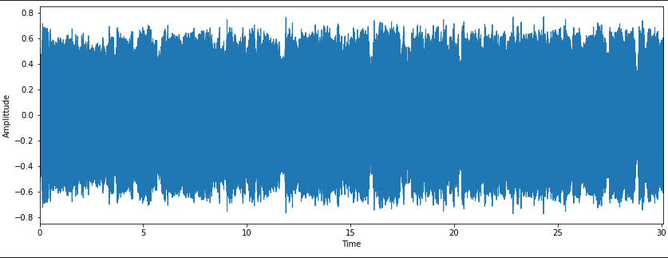
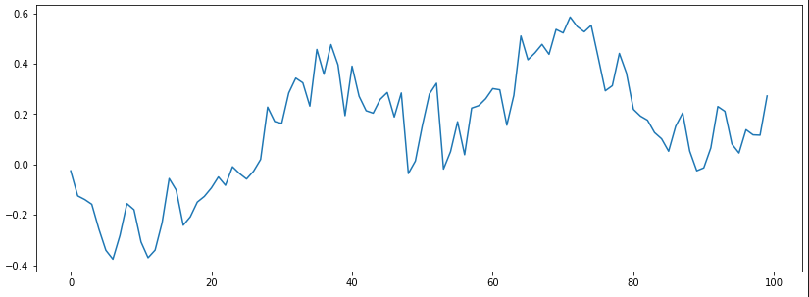
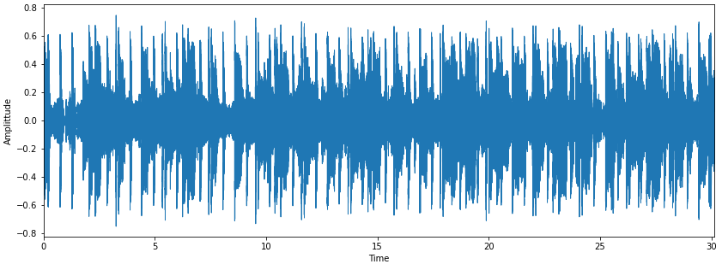
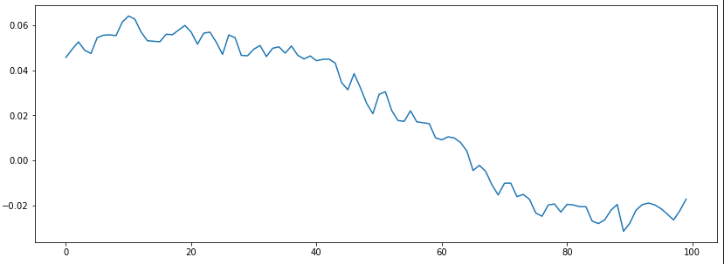
Pop Zero Crossings: 15
Rock Zero Crossings :8
Country Zero Crossings :7
Disco Zero Crossings : 1

Slide 9
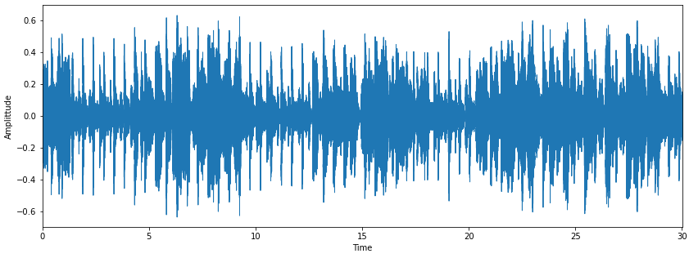
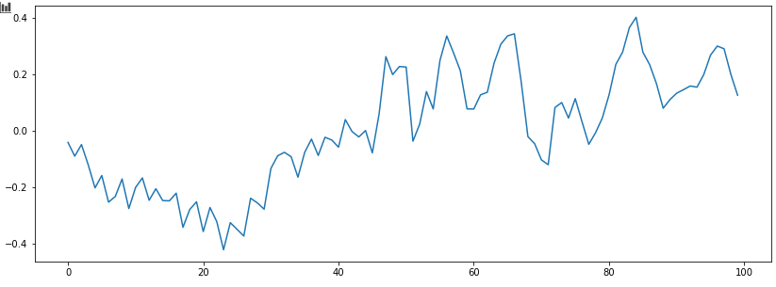
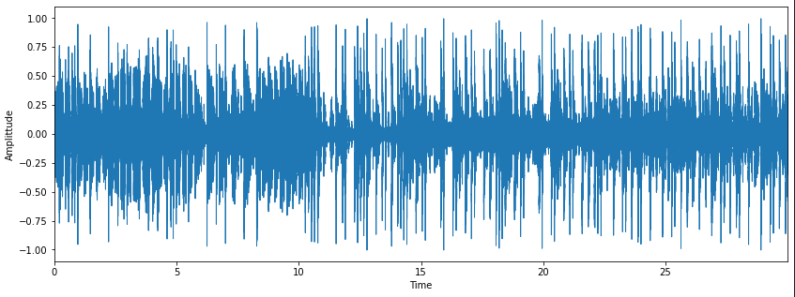
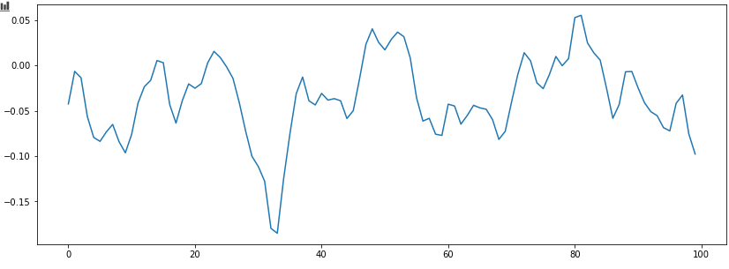
Reggae Zero Crossings:11
Hip Hop Zero Crossings: 12

Slide 10
MFCC
Small set of features (20 in our case)
Describe the overall shape of a spectral envelope
Human perception of speech/sound is linear until 1000 Hz Range(100-3200 Hz) and logarithmic from threre
Cepstrum = ST(add in) Fourier Transform (logarithmic ( Fourier Transform (Sound)))

Slide 11
Chroma
Test

Slide 12
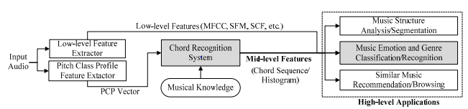
Chord Feature
Taking the Chromagramm and extract the Pitch Class Profile
Calculate the Transition Matrix
Train the Neural Network

Slide 13
Our models
LogisticRegression
RandomForests
SupportVectorMachine
Multi-Layer-Perceptron

Slide 14
Model Selection: Multi-Layer-Perceptron (MLP)
Parameter grid with
hidden_layer_sizes: (100) , (100,50) and (50,50,50)
activation: ‘relu‘ and ‘logistic‘
solver: ‘lbfgs’ (quasi-Newton optimizer) and ’adam’ (based on stochastic gradient descent)
alpha: 0.0001 and 0.01
learning_rate: ‘constant‘, ‘invscaling’ and ‘adaptive’
max_iter: 250, 500 and 750

Slide 15
Model Selection: Multi-Layer-Percepton (MLP)
A cross-validated grid-search over this parameter grid (with GridSearchCV and Kfold) yielded:
 | Scaler | Hidden_layer_size | Activation | Solver | Alpha | Learning_rate | Max_iter | Score
All features |  | (100,50) | Logistic | adam | 0.0001 | Adaptive | 250
All except chords
Chroma
Spec
Zero
Mfcc
Chords

Slide 16
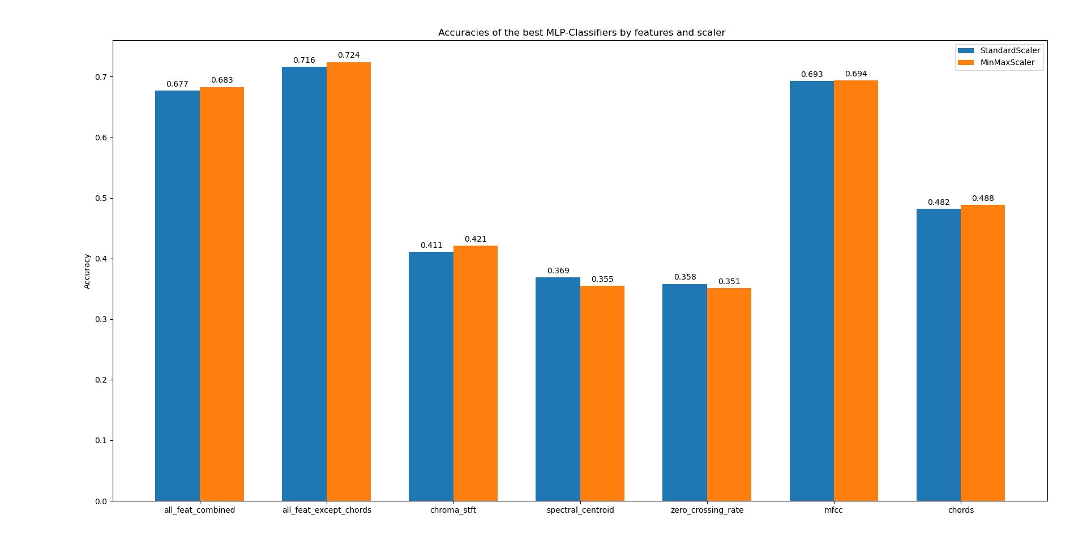

Slide 17
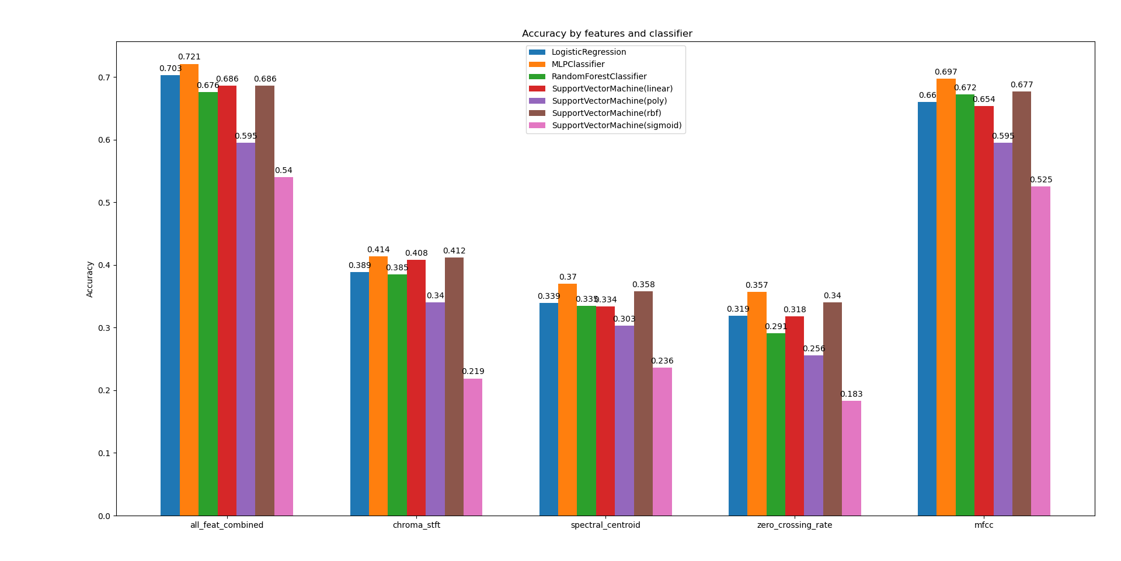
Evaluation

Slide 18
Confusion Matrices
Test

Slide 19
Florians
Test

Slide 20
Input-Pipeline
Job:
input costum data to be classified.
arrange data to be accessible for the feature- and model boxes
Approach:
team needs 1-D numpy arrays of audio-samples, due to Librosa-specification
therefore, develop routine to read/record audio-files and convert these into required numpy arrays
libraries: pydub (requires: FFMPEG), sounddevice

Slide 21
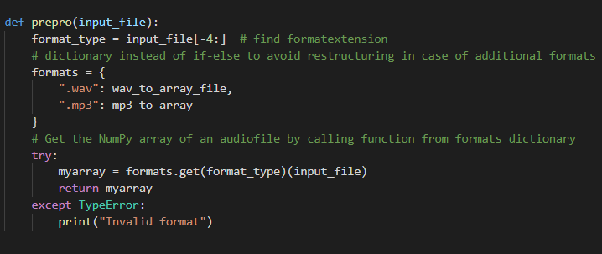
Input-Pipeline
Read & Convert Files:
input: File
master function reads and delegates tasks to appropriate functions
decided for WAV and MP3
use dictionary to make code easily extendable
return: array

Slide 22
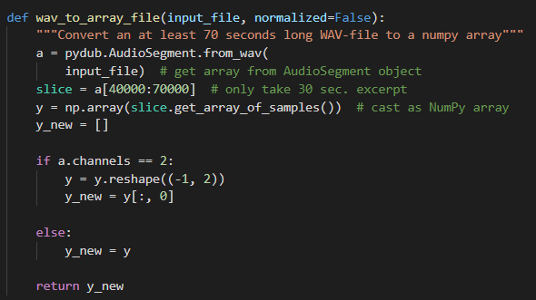
Input-Pipeline
Convert file to array:
input: file
only take 30 seconds of audio , needed for the classifyer
each channel has an independent audio signal, so taking one channel for samples should suffice
return: array

Slide 23
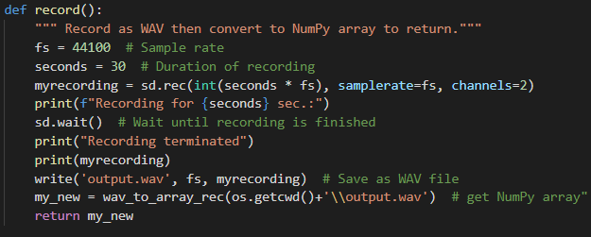
Input-Pipeline
Record:
record for 30 seconds to WAV
technical part outsourced to Sounddevice
convert WAV to array of samples
return: array

Slide 24
Outlook:
Possible next/further steps
Feature based: extract more features (eg. spectral-rollof), compare standard deviation with variance
Data based: Use 1million songs data set
Model based: scale with sklearn.Normalizer, cross-validated grid-search for all Classifiers
GUI?

Slide 25
References
https://towardsdatascience.com/music-genre-classification-with-python-c714d032f0d8
Valerio Velardo - The Sound of AI (YouTube Channel)
https://towardsdatascience.com/musical-genre-classification-with-convolutional-neural-networks-ff04f9601a74
MSc Computer Science, University of Birmingham,‘‘Machine Learning for Music Genre Classification‘‘, Author: Bryn Lansdown, Supervisor: Dr. Shan He

Slide 26
Task Distribution
…uniformly distributed

Slide 27
Appendix

Slide 28
Code
You can find the code at:
https://github.com/MrGandalv/MUGGE

